Slide 1
Database Management
Systems
UNIT-1
By Santoshh s potti

Slide 2
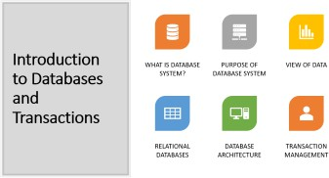
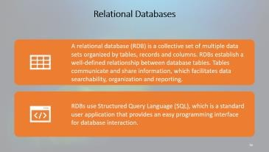
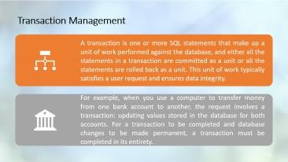
Chapter 1: Introduction to Databases and Transactions

Slide 3
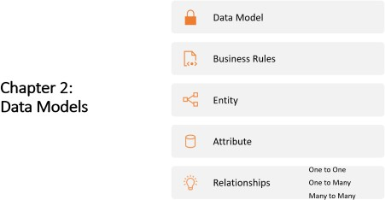
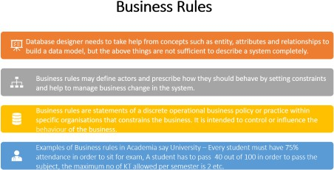
Chapter 2: Data Models

Slide 4
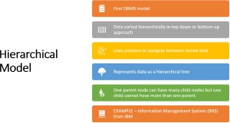
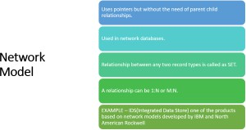
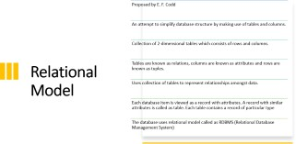
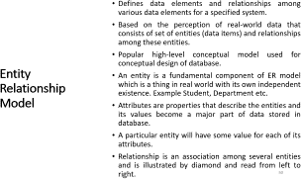
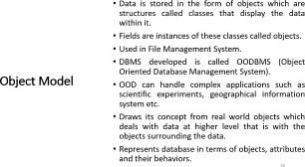
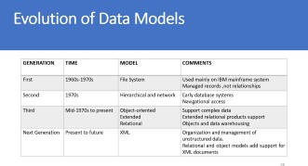
Chapter 2: Data Models

Slide 5
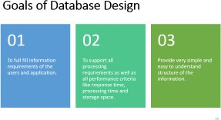
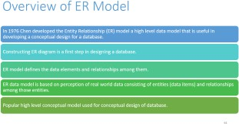
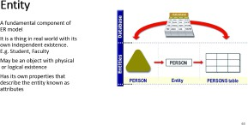
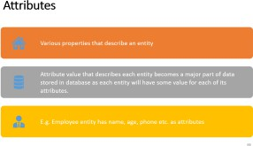
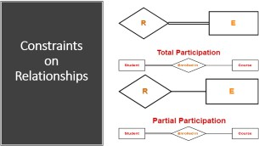
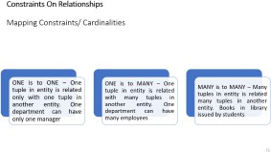
Chapter 3: Database Design and ER Diagrams

Slide 6
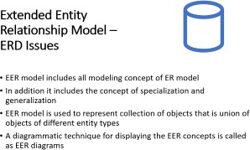
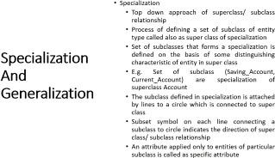
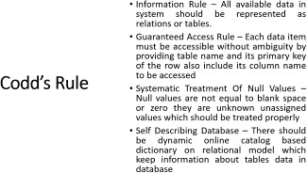
Chapter 3:EER Model

Slide 7
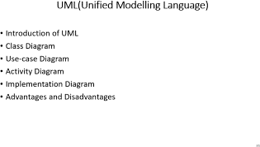
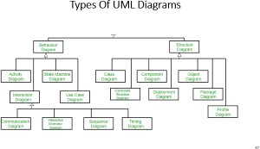
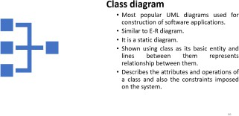
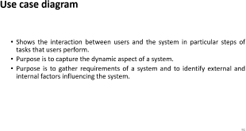
Chapter 3:UML Diagrams

Slide 8
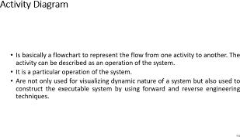
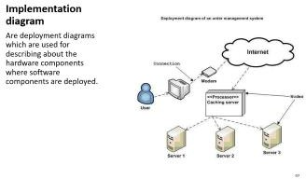
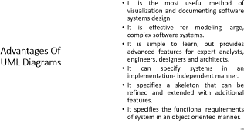
Chapter 3:UML Diagrams

Slide 9

WHAT IS DATABASE SYSTEM?
Introduction to Databases and Transactions
PURPOSE OF DATABASE SYSTEM
VIEW OF DATA
RELATIONAL DATABASES
DATABASE ARCHITECTURE
TRANSACTION MANAGEMENT

Slide 10
Data & Database & Database Management System
Data
The fact and figures that can be recorded in system and that have some special meaning assigned to it. For Example: Data of a customer is name, telephone number, address, product purchased etc.
Database
A database is a collection of related data items stored at one place.
For example: College database stores information about students , teachers, classes, subjects(All related data).
DBMS is a software system that helps in the process of defining, constructing , manipulating the database. It is also known as computerized record-keeping system.

Slide 11


Data- As a corporate resource
Data Availability
Need of data in Database system
Maintaining Complex data
Data independence and efficient access.
Data integrity and security.
Concurrent access, recovery from crashes.

Slide 12

Benefits of Database System over File System
REDUNDANCY CAN BE REDUCED
INCONSISTENCY CAN BE AVOIDED
DATA CAN BE SHARED
SECURITY RESTRICTIONS CAN BE APPLIED
INTEGRITY CAN BE MAINTAINED

Slide 13
Applications of DBMS
TELECOM
INDUSTRY BANKING SYSTEM
EDUCATION SECTOR
ONLINE SHOPPING

Slide 14
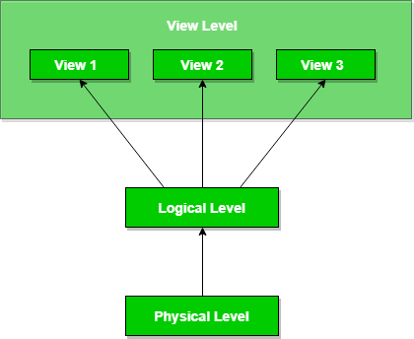



Three levels of Data Abstraction
Physical level: This is the lowest level of data abstraction.
Logical level: This is the middle level of 3-level data abstraction.
View level: Highest level of data abstraction.

Slide 15

Schema and Instance in DBMS
Design of a database is called the schema
Physical Schema
Logical Schema
View Schema
The data stored in database at a
moment of time is called instance of database.

Slide 16

Relational Databases
A relational database (RDB) is a collective set of multiple data sets organized by tables, records and columns. RDBs establish a well-defined relationship between database tables. Tables communicate and share information, which facilitates data searchability, organization and reporting.
RDBs use Structured Query Language (SQL), which is a standard user application that provides an easy programming interface for database interaction.

Slide 17

Relational DBMS (RDBMS)
Introduction
Was introduced by Dr.
E.F.Codd in 1970 .
Standard for relational databases is published by ANSI(the American National Standard Institute)
Features
A relational database is composed of many relations in the form of two-dimensional tables of rows and columns containing related tuples known as logical view.
Tables/Relations are a logical structure which is a collection of 2-dimensional tables consists of horizontal rows and vertical columns.

Slide 18


SUPPORTS DATA INDEPENDENCE.
ADVANTAGES
USE OF OOPS CONCEPT
HIGHLY SECURED DATA.
MULTIPLE USERS CAN ACCESS WHICH IS NOT POSSIBLE IN SIMPLE DBMS.
DISADVANTAGES
INABILITY TO HANDLE APPLICATION AREAS LIKE SPATIAL DATABASES(EG-CAD) ,APPLICATIONS INVOLVING IMAGES ETC.

Slide 19
Database architecture
Database architecture can be 2-tier or 3 tier architecture based on how users are connected to the database to get their request done. They can either directly connect to the database or their request is received by intermediary layer, which synthesizes the request and then it sends to database.

Slide 20
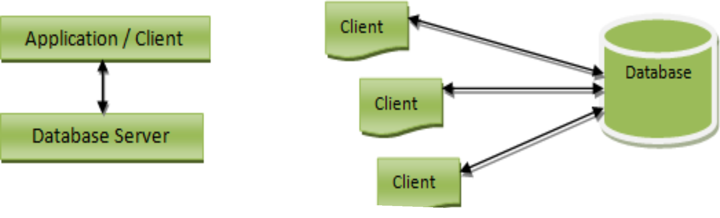
In 2-tier architecture, application program directly interacts with the database. There will not be any user interface, or the user involved with database interaction
2-tier Database Architecture
20

Slide 21


Advantages of 2-tier Architecture:
Easy to understand
Easy to retrieve Easy to modify Easy to maintain
Disadvantages of 2-tier architecture:
Time consuming Cost effective.

Slide 22
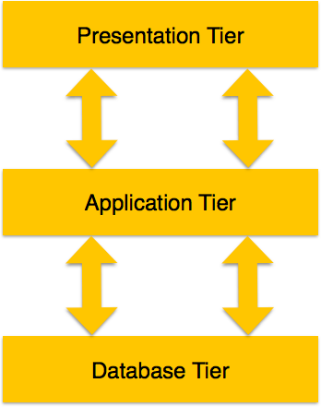
3-tier Architecture
22
A 3-tier architecture
separates its
tiers from each other based on the complexity of the users and how they use the data present in the database. It is the most widely used architecture to design a DBMS.

Slide 23



Database (Data) Tier − At this tier, the database resides along with its query processing languages. We also have the relations that define the data and their constraints at this level.
Application (Middle) Tier − At this tier the application server reside and the programs that access the database. For a user, this application tier presents an abstracted view of the database. End-users are unaware of any existence of the database beyond the application. At the other end, the database tier is not aware of any other user beyond the application tier. Hence, the application layer sits in the middle and acts as a mediator between the end-user and the database.
User (Presentation) Tier − End-users operate on this tier and they know nothing about any existence of the database beyond this layer. At this layer, multiple views of the database can be provided by the application. All views are generated by applications that reside in the application tier.

Slide 24

Transaction Management
A transaction is one or more SQL statements that make up a unit of work performed against the database, and either all the statements in a transaction are committed as a unit or all the statements are rolled back as a unit. This unit of work typically satisfies a user request and ensures data integrity.
For example, when you use a computer to transfer money from one bank account to another, the request involves a transaction: updating values stored in the database for both accounts. For a transaction to be completed and database changes to be made permanent, a transaction must be completed in its entirety.

Slide 25
Properties of Transaction
1. Atomicity
2. Consistency
Isolation
Durability
25

Slide 26
BEGIN TRANSACTION transfer
Deduct Rs.100 from account A
Add Rs.100 to account B
If no errors, then
Save changes made by this operation
Else
Delete changes made by this operation
End If
END TRANSACTION transfer
26

Slide 27
Data Model
Business Rules
Chapter 2: Data Models
Entity
Attribute
One to One One to Many Many to Many
Relationships

Slide 28
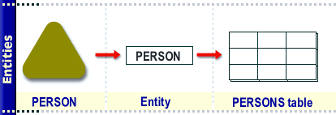
Entity
A fundamental component of a model which has its own independent existence in real world. E.g. A Student, Faculty, Subject.
An entity can be an object with physical existence, or it may have logical
existence.
Entities like department, section, adults may have physical or logical existence

Slide 29
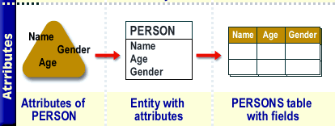
Attributes
Each entity has its own properties which describes that entity, such properties are called as attributes.
A particular entity will have some value for each of its attributes.
EXAMPLE – Employee entity may be described by attributes name, age, phone etc.

Slide 30
Relationship
It is an association among several entities for e. g. Employee works for Department.
The degree of the relationship is the number of participating entity types in a particular relation.
For example, there is a relationship between customers and agents that may be described as “an agent can serve many customers and each customer may be served by one agent".

Slide 31
Types Of Relationships
One is to one – One entity is associated with at most one other entity.
E.g. One department can have only one manager
One is to Many – One entity is associated with any number of entities in other entity. E.g. One teacher may teach to many students
Many is to Many – Many entity is associated with any number of entities in other entity. E.g. Books in library issued by students

Slide 32
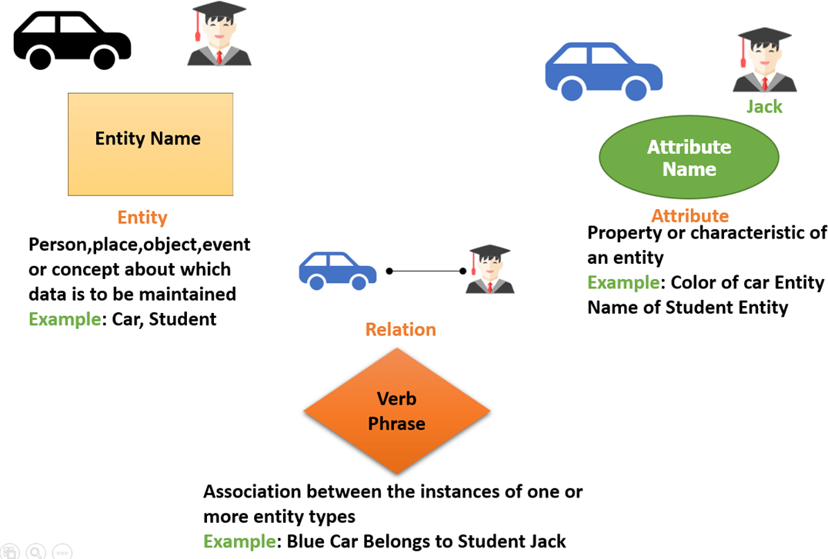

Slide 33

Business Rules
Database designer needs to take help from concepts such as entity, attributes and relationships to build a data model, but the above things are not sufficient to describe a system completely.
Business rules may define actors and prescribe how they should behave by setting constraints and help to manage business change in the system.
Business rules are statements of a discrete operational business policy or practice within specific organisations that constrains the business. It is intended to control or influence the behaviour of the business.
Examples of Business rules in Academia say University – Every student must have 75% attendance in order to sit for exam, A student has to pass 40 out of 100 in order to pass the subject, the maximum no of KT allowed per semester is 2 etc.

Slide 34
DEFINITIONS – Define some business terms. Definitions are incorporated in systems data dictionary. E.g. A professor is someone who teaches to students
FACTS – Connect business terms in ways that make business sense. Facts are implemented as relationships between various data entities E.g. A professor may have student.
CONSTRAINTS – Shows how business rules and how business terms are connected with each other. Constraints usually state how many of one data entity can be related to another data entity E.g. Each professor may teach up to four subjects.
DERIVATIONS – Enable new knowledge or actions. Derivations are often implemented as formulas and triggers. E.g. A student pending fees is his fees paid minus total fees.
Types of Business Rules

Slide 35
Atomicity – Rule should define any one aspect of the system environment. E.g. College should have students in it.
Business Format – Rule should be expressed in business terms understandable to businesspeople.
E.g. ER diagrams, Object diagrams etc.
Business Commonality – Each rule should confirm business scope. E.g. College system must define characteristics in college database.
Business Ownership – Each rule is governed by a businessperson who is responsible for verifying it, enforcing it and monitoring need for change. E.g. End user or customer is responsible for requirements submitted by him.
Characteristics of Business Rule

Slide 36
Classification – Each rule can be classified by its data and constraints.
Business Formalism
– Each rule can be related information
implemented in the
system. Business rules should be consistent and non-redundant.
EXAMPLES
A student may take admission to college
One subject is taught by only one professor
A class consists of minimum 60 and maximum 80 students

Slide 37

Method Of Defining Business Rules
DEFINE THE SCOPE OF YOUR ANALYSIS
STATE THE OBJECTIVES OF THE DEFINED SCOPE
IDENTIFY THE ACTORS WITHIN THE DEFINED SCOPE
UNCOVER BUSINESS CONFUSIONS
CREATE ONE OR MORE USE CASES
IDENTIFY SYSTEM DECISIONS

Slide 38
First DBMS model
Data sorted hierarchically in top down or bottom up approach
Hierarchical Model
Uses pointers to navigate between stored data
Represents data as a hierarchical tree
One parent node can have many child nodes but one child cannot have more than one parent.
EXAMPLE – Information Management System (IMS) from IBM

Slide 39
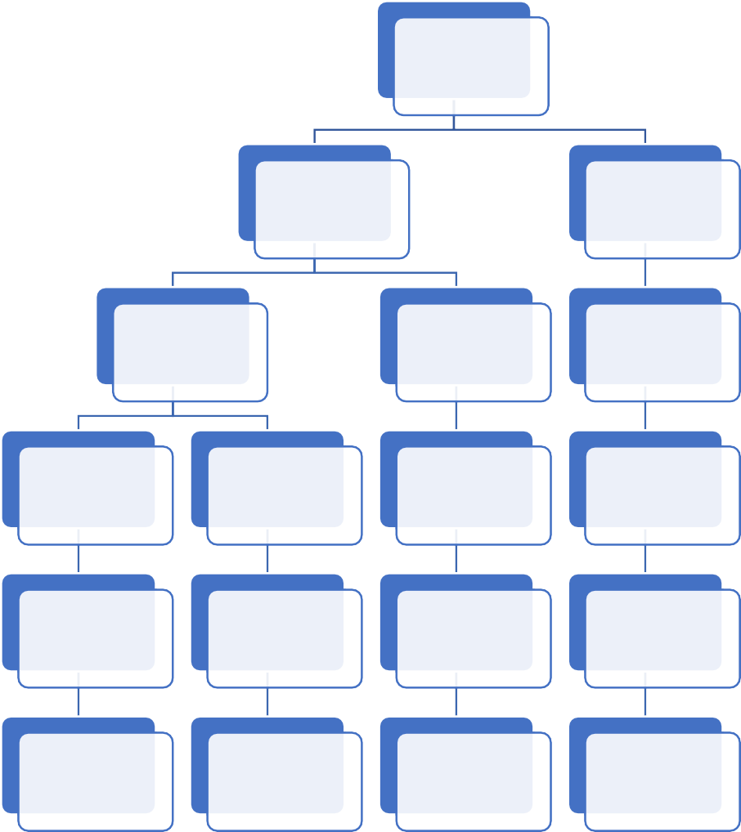
Example-Hierarchical Model
CEO
PM
PM
PrM
PrM
PrM
PL
PL
PL
PL
TL
TL
TL
TL
Developer
Developer
Developer
Developer

Slide 40
Advantages Of Hierarchical Model
Conceptual Simplicity
Relationships between various levels is logically very simple. Hence database structure becomes easier to view
Database Security
Security is given by DBMS itself it does not depends on programmer has given security or not
Simple Creation, Updation And Access
It is simple to construct with the help of pointers. Adding and deleting records is easier . Faster and
easy data retrieval
Database Integrity
There is always parent child relation between different levels and hence child records are attached with parent records which maintains data integrity
Data Independence
Itself maintains data independence thus reducing program efforts and its maintenance that is if one part of the code is changed no need to change the other part
Efficiency
Good performance when database contains large amount of data in which one record has many related records

Slide 41
Complex implementation
Only data independence is not enough for designer and programmers to build database system they need to have knowledge of physical data storage which may be complex.
Difficult to manage
Disadvantages Of Hierarchical Model
Any change in location of data needs change in all application programs that accesses changed data. Data access is restricted by pointer path.
Lack of structural independence
Change in database structure affects data access.
Complex application programming
Programmers must know how data is stored and path of data storage.
Limitations in implementation
1:N relationship can be implemented but implementing
M:N relationship is difficult.

Slide 42
Uses pointers but without the need of parent child relationships.
Used in network databases.
Network Model
Relationship between any two record types is called as SET.
A relationship can be 1:N or M:N.
EXAMPLE – IDS(Integrated Data Store) one of the products based on network models developed by IBM and North American Rockwell

Slide 43
Example- Network Model
A
B
C
E
F
D

Slide 44
Simple Design
Is simple and easy to design and understand.
Ability to handle many types of relationship
Can handle one-to-many or many-to-many or other relationships and hence manages multi user environment.
Advantages Of Network Model
Ease of data access
An application can access a parent record and all the member records within a set.
Data Independence
Application programs work independently of the data. Any changes made in data do not affect the application program.
Conformance to standards
Facilitates the administrators portability by offering data creation by DDL and DML.

Slide 45
System Complexity
Data are accessed one record at a time hence the complexity for the system
Disadvantages Of Network Model
increases for accessing multiple
records at a time.
Lack Of Structural Independence
Any changes made to the database
structure or data require the application programs to be modified before it can access data.

Slide 46

An attempt to simplify database structure by making use of tables and columns.
Proposed by E. F. Codd
Collection of 2-dimensional tables which consists of rows and columns.
Relational Model
Tables are known as relations, columns are known as attributes and rows are known as tuples.
Uses collection of tables to represent relationships amongst data.
Each database item is viewed as a record with attributes. A record with similar attributes is called as table. Each table contains a record of particular type
The database uses relational model called as RDBMS (Relational Database Management System)

Slide 47

COLUMNS
Example-Relational Model
ROWS
 |  | VALUE
TABLE

Slide 48
Relational Algebra
Supports relational algebra, union, intersection, difference, Cartesian product, select, project, join and division
Dynamic View
View is not a part of physical schema, hence changing data in the table also changes the data present in the view
Advantages Of Relational Model
SQL
English like language which can be used to access data form RDBMS. Most vendors support SQL
Excellent Data Security
Support the concept of user rights thus meeting the needs of databases
Performance
Performance and support to new hardware technologies and flexible for all types of data needs
Scalability
Scalable and provide good support for the implementation of distributed systems and other advanced database systems

Slide 49
Relational
databases can
sometimes become complex as the amount of data grows, and the
relations between pieces of data become more complicated.
Disadvantages Of Relational Model
Complex relational systems may lead to
database isolated
databases where the information cannot be shared from one system to another.

Slide 50
Defines data
elements and relationships among
various data elements for a specified system.
Based on the perception of real-world data that consists of set of entities (data items) and relationships among these entities.
Popular high-level conceptual model used for
conceptual design of database.
An entity is a fundamental component of ER model which is a thing in real world with its own independent existence. Example Student, Department etc.
Attributes are properties that describe the entities and its values become a major part of data stored in database.
A particular entity will have some value for each of its
attributes.
Relationship is an association among several entities and is illustrated by diamond and read from left to
Entity Relationship Model
right.
50

Slide 51
Entity Relationship Model Contd..
DEPTNO
EMPNO
EMPNAME
DEPARTMENT
CONTAINS
EMPLOYEES
DEPTNAME
EMPAGE
LOCATION
EMPSAL
51

Slide 52
Very Simple Design
Simple and easy to design
logical view of data.
Advantages Of ER Model
Designer, programmer, developer can understand system very easily by looking at an ER model constructed.
Ease Of
Representation
Integrated With Relational Databases
Completely integrated with relational model which can offer well structured design process.

Slide 53
Limited Constraint Representation
Model can display those constraint that are directly tied by relationships but not possible to represent some constraints like average marks etc.
Disadvantages Of ER Model
No DML
Do not have any language by which we can
insert data in database.
Loss Of Information Content
Does not deal with actual data values so it may not be possible to represent information content of system.

Slide 54
Data is stored in the form of objects which are structures called classes that display the data within it.
Fields are instances of these classes called objects.
Used in File Management System.
DBMS developed is called OODBMS (Object
Oriented Database Management System).
Object Model
OOD can handle complex applications such as
scientific experiments, geographical information
system etc.
Draws its concept from real world objects which deals with data at higher level that is with the objects surrounding the data.
Represents database in terms of objects, attributes and their behaviors.

Slide 55
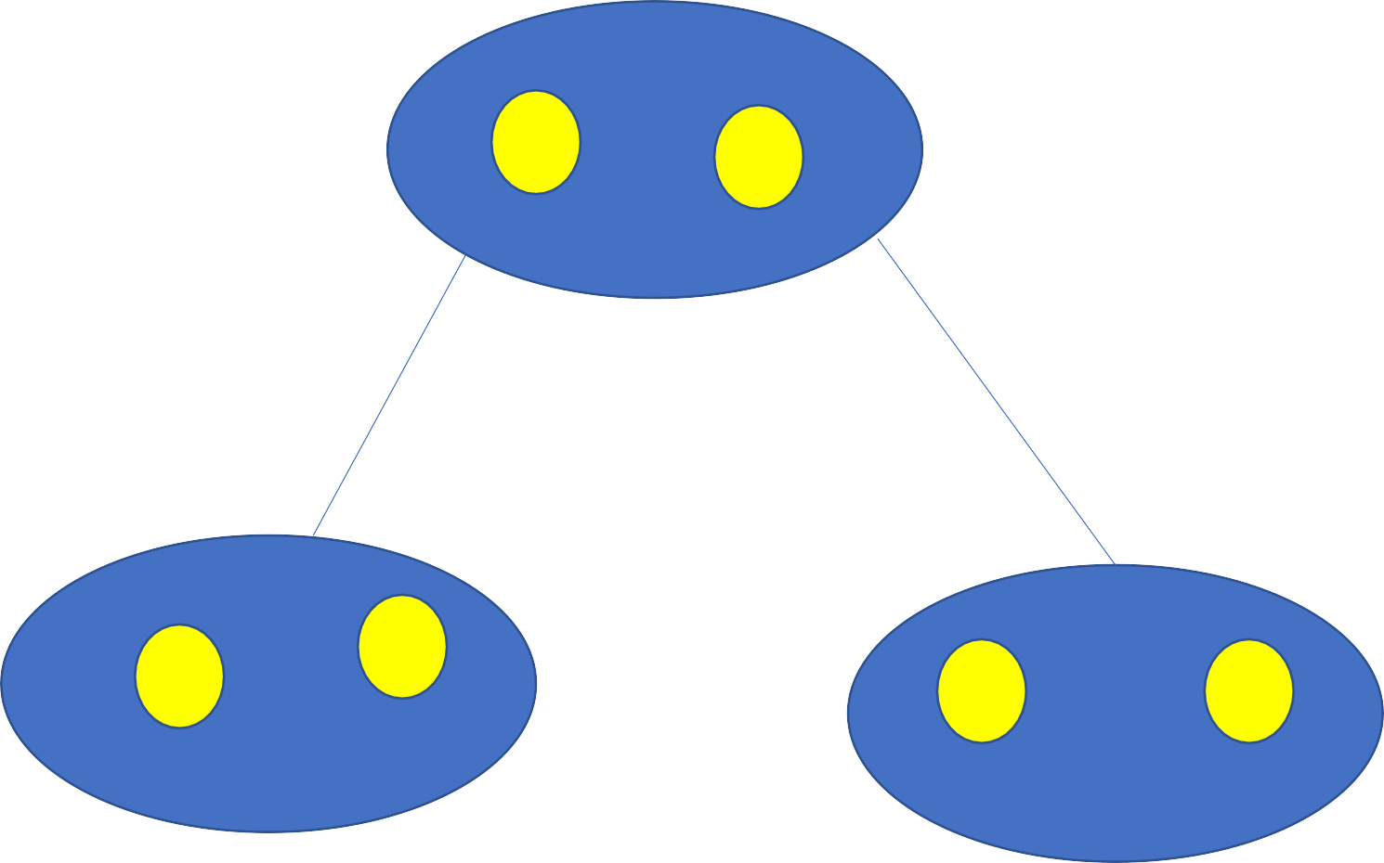
Object Model Contd..
A
X
Z

Slide 56
OO features provide a clear modular structure which is good for designing abstract data types where internal implementation details are hidden.
Advantages Of Object Model
Easy to maintain and modify existing code as we can create new model with small change in existing.
10

Slide 57
Disadvantages Of Object Model
Often provided through object-oriented languages such as C++ and Java.
Practically very complex and inapplicable many times.

Slide 58
Evolution of Data Models
GENERATION | TIME | MODEL | COMMENTS
First | 1960s-1970s | File System | Used mainly on IBM mainframe system Managed records ,not relationships
Second | 1970s | Hierarchical and network | Early database systems Navigational access
Third | Mid-1970s to present | Object-oriented Extended Relational | Support complex data Extended relational products support Objects and data warehousing
Next Generation | Present to future | XML | Organization and management of unstructured data. Relational and object models add support for XML documents

Slide 59
Goals of Database Design
01
To full fill information requirements of the users and application.
02
To support all processing requirements as well as all performance criteria like response time, processing time and storage space.
03
Provide very simple and easy to understand structure of the information.

Slide 60
Phases of database design process
One must know goals of the system, expectations of the end users and uses of database application in detailed manner.
Check all data requirements produced by the previous phase and design the characteristics of known database transactions.
The choice of DBMS depends upon factors like technical, economical etc.
Simple abstractions of real world data gives the idea of how the system will work.
Select the data structure and access paths of database files to achieve good performance.
Database system can be implemented only after logical and physical design is implemented.

Slide 61
Overview of ER Model
In 1976 Chen developed the Entity Relationship (ER) model a high level data model that is useful in developing a conceptual design for a database.
Constructing ER diagram is a first step in designing a database.
ER model defines the data elements and relationships among them.
ER data model is based on perception of real world data consisting of entities (data items) and relationships
among those entities.
Popular high level conceptual model used for conceptual design of database.

Slide 62
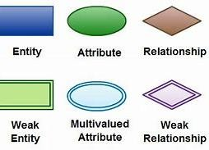
ER Diagrams
Diagrams/Notations used in ER diagrams
Rectangle entity sets Ellipses attributes Diamonds relationship sets
Lines link attributes to entities and entities with entities
Double Rectangles weak entity sets
62

Slide 63
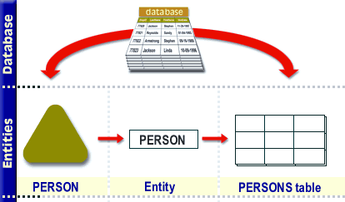
Entity
A fundamental component of ER model
It is a thing in real world with its own independent existence.
E.g. Student, Faculty
May be an object with physical or logical existence
Has its own properties that describe the entity known as attributes
63

Slide 64
Collection of all entities of same type
Strong Entity –
Entity type having own distinct primary key by which we can identify specific entity uniquely.
E.g. Empno in Emp table, RollNo in Student table. Represented by single rectangle
Entity set
Weak Entity –
Entity type which cannot form distinct primary key from their attributes.
These type of entities are dependent on strong entity for primary key.
Some weak entities contain virtual primary key called as Discriminator. Represented by double rectangle

Slide 65

Difference between Entity Sets
Strong entity set | Weak entity set
A single rectangle is used for the representation of a strong entity set. | A double rectangle is used for the representation of a weak entity set.
It contains sufficient attributes to form its primary key. | It does not contain sufficient attributes to form its primary key.
A diamond symbol is used for the representation of the relationship that exists between the two strong entity sets. | A double diamond symbol is used for the representation of the identifying relationship that exists between the strong and weak entity set.
A single line is used for the representation of the connection between the strong entity set and the relationship. | A double line is used for the representation of the connection between the weak entity set and the relationship set.
Total participation may or may not exist in the relationship. | Total participation always exists in the identifying relationship.

Slide 66

Attributes
Various properties that describe an entity
Attribute value that describes each entity becomes a major part of data stored in database as each entity will have some value for each of its attributes.
E.g. Employee entity has name, age, phone etc. as attributes
66

Slide 67
Simple Attributes
Composite Attributes Single Valued Attribute
Multi Valued Attribute
Attributes
Stored Attributes
Derived Attributes Null Attribute
Key Attribute

Slide 68
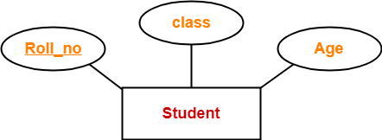
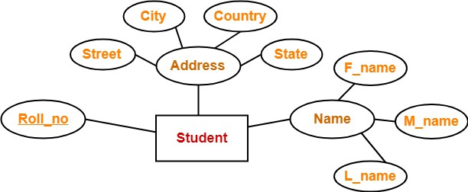
Simple Attributes: Which cannot be divided into sub parts. Example: Salary of employee
Composite Attributes: Which can be divided into sub parts E.g. Name can be divided into FirstName and LastName
Attributes

Slide 69
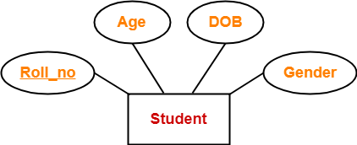
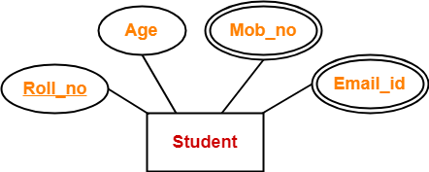
Single Valued Attribute: Having atomic (only one) value for
particular entity. E.g. Student has only one roll no
Multi Valued Attribute: Many values for a particular entity E.g. Employee has multiple mobile numbers
Attributes

Slide 70
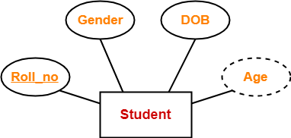
Stored Attributes: Simple attributes stored in database
E.g. DateOfJoin for Employee
Derived Attributes: Value of this attribute is derived
Attributes
from value of related stored attribute E.g.
EmployeeTenure can be calculated from DateOfJoin
70

Slide 71
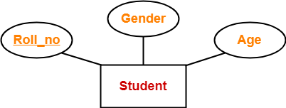
Null Attribute: Can take a null value when entity does not have a value for it or the value is unknown. E.g. Commission attribute in Employee table specifies whether the Employee has commission or not
Key Attribute: Must have a unique value by which any row can be identified. E.g. Deptno for department table
Attributes
71

Slide 72
Constraints On Relationships
Mapping Constraints/ Cardinalities
ONE is to ONE – One
ONE
tuple with
is to MANY – One in entity is related
tuple in entity is related
MANY is to MANY – Many tuples in entity is related
only with one tuple in
many tuples in
another entity. One
have
another department
entity. One
can have
many tuples in another
library
entity. Books in
department can
issued by students
only one manager
many employees
72

Slide 73
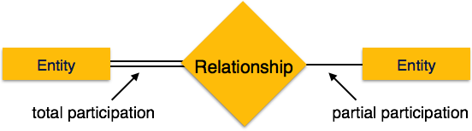
Total Participation
Partial Participation
Constraints On Relationships
Every object in an entity must
participate in relationship
Indicated by dark or double line between entity and relationship
Every department must have manager
More than one object in an entity may participate in a relationship
Indicated by single line between entity and relationship
Employee works for department
Participation Constraints
73

Slide 74
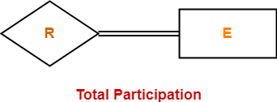

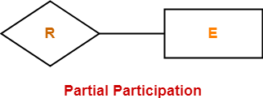
Constraints on Relationships

Slide 75
Cardinality Ratio Notation
Use cardinality of each identity involved in relation
1 (Exactly One Instance), M (Many Instances), N (Any Number Of Instances) specifies on each entity of binary relationship
Notations Used in ER Diagrams
Min-Max Notation
(Min , Max) notation represents entity is related to at least min, at most max relationship instance in relationship set

Slide 76
Limitations Of Entity Relationship Model
One cannot represent relationship like inheritance in ER diagrams
No relationships is defined between entity type and relationship type
No relationship is defined between entity type and collection of entity type from which one may participate.

Slide 77
Extended Entity Relationship Model – ERD Issues
EER model includes all modeling concept of ER model
In addition it includes the concept of specialization and generalization
EER model is used to represent collection of objects that is union of objects of different entity types
A diagrammatic technique for displaying the EER concepts is called as EER diagrams

Slide 78
Sub Class – Super Class And Inheritance
Super Class
The class has its sub groupings
An entity cannot exist in database merely by being member of any super class
Sub Class
A sub grouping of super class
More specific version of super class
Inherits properties and attributes from its super class
Super Class And Sub Class Relationship
Relationship between super class and sub class is called Superclass/Subclass relationship
Shown by encircled
d
Leads to concept of Inheritance

Slide 79
Inheritance
Important concept associated
with subclass
Type of an entity is defined by an attribute poses by a relationship types in which they participates
Entity in subclass represent entity from upper class it should poses
Inheritance
value for specific attribute as member of super class
Entity represents all relationships in which super class participates
Entity that is the member of subclass inhabits all attributes of entity as a member of super class

Slide 80
Specialization
Top down approach of superclass/ subclass
relationship
Process of defining a set of subclass of entity type called also as super class of specialization
Set of subclasses that forms a specialization is
Specialization And Generalization
defined on the basis of some distinguishing
characteristic of entity in super class
E.g. Set of Current_Account) superclass Account
subclass (Saving_Account, are specialization of
The subclass defined in specialization is attached by lines to a circle which is connected to super class
Subset symbol on each line connecting a subclass to circle indicates the direction of super class/ subclass relationship
An attribute applied only to entities of particular subclass is called as specific attribute

Slide 81

Generalization
Reverse process of specialization or bottom up approach of super class/ subclass relationship
Process in which we differentiate among several entity types identifying their common features and generalizing them into single super class of which original entity type are special subclasses
E.g. Car and Bike do have several common attributes that can be generalized to super class vehicle
In diagrammatical notation arrow pointing to generalized super class represents generalization and arrow pointing to generalized subclass represents specialization
Attributes created of higher or lower level entities are attributes inheritance

Slide 82
Information Rule – All available data in system should be represented as relations or tables.
Guaranteed Access Rule – Each data item must be accessible without ambiguity by providing table name and its primary key of the row also include its column name to be accessed
Systematic Treatment Of Null Values – Null values are not equal to blank space or zero they are unknown unassigned values which should be treated properly
Self Describing Database – There should
Codd’s Rule
be dynamic online catalog based dictionary on relational model which keep information about tables data in database

Slide 83
Comprehensive Data Sublanguage – The data access language (SQL) must be the only means of accessing data stored in the database and support DML, DDL etc.
View Updating Rule – All views of data are theoretically updateable can be updated using system also
High Level Insert, Update And Delete – This rule states that in a relational database , the query language must be capable of performing manipulations on sets of rows in a table
Codd’s Rule
Physical | Data | Independence | – Any
changes | made | in the way is | physically
stored must not affect applications that access data

Slide 84
Logical Data Independence – This rule states that changes to the database to the database design should be done in a way without the users being aware of it
Integrity Independence – Data integrity constraints which are definable in the
language must be stored in the database as data in table is, in the catalog and not in the application program
Distribution Independence – In a RDBMS data can be stored centrally that is on a
Codd’s Rule
system or distributed across multiple systems
constraints by any other languages
Non | Subversion Rule | – This | rule states
that | there should | be no | bypass of

Slide 85
UML(Unified Modelling Language)
Introduction of UML
Class Diagram
Use-case Diagram
Activity Diagram
Implementation Diagram
Advantages and Disadvantages

Slide 86
Introduction To UML
UML is
a standard language for specifying visualizing, constructing and
documenting the artifacts of software systems.
UML is specially proposed standard for creating specifications of various
components of a complex software system.
UML stands for Unified Modelling Language.
UML is different from the other common programming languages like C++,Java etc.
UML is a specification language that is used in the software engineering field.

Slide 87
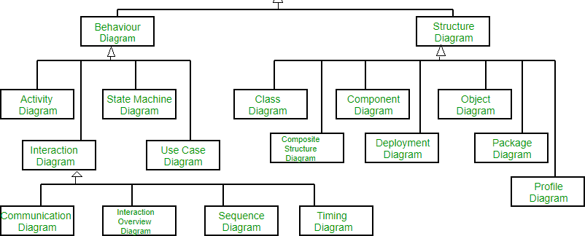
Types Of UML Diagrams

Slide 88
Class diagram
Most popular UML diagrams used for construction of software applications.
Similar to E-R diagram.
It is a static diagram.
Shown using class as its basic entity and lines between them represents relationship between them.
Describes the attributes and operations of a class and also the constraints imposed on the system.
88

Slide 89
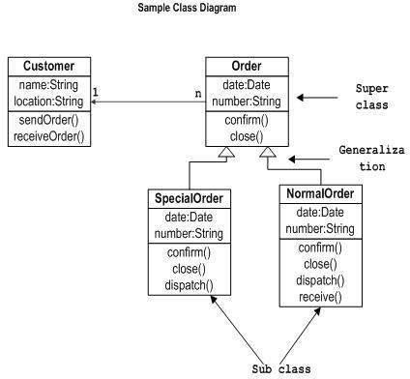
Class Diagram for Customer Order

Slide 90
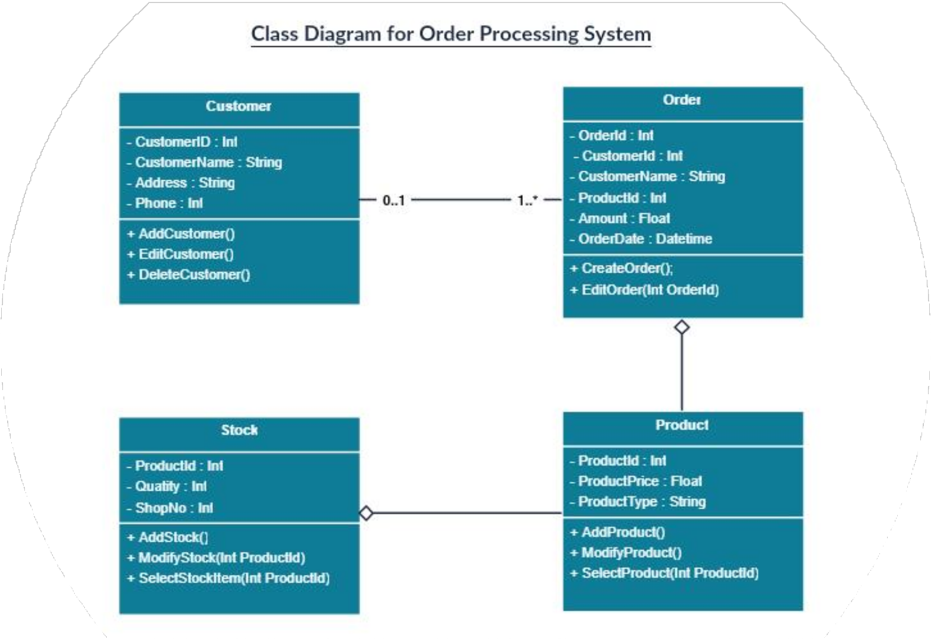

Slide 91
Use case diagram
Shows the interaction between users and the system in particular steps of tasks that users perform.
Purpose is to capture the dynamic aspect of a system.
Purpose is to gather requirements of a system and to identify external and
internal factors influencing the system.

Slide 92
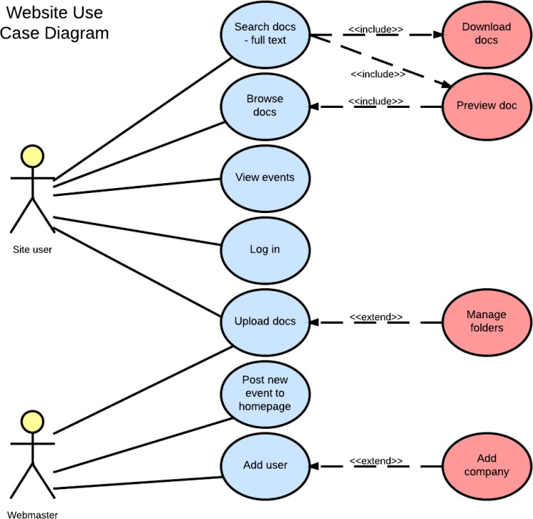

Slide 93

Use case Diagram for User1-Admin User 2-
Customer

Slide 94
Activity Diagram
Is basically a flowchart to represent the flow from one activity to another. The activity can be described as an operation of the system.
It is a particular operation of the system.
Are not only used for visualizing dynamic nature of a system but also used to construct the executable system by using forward and reverse engineering techniques.

Slide 95

Activity Diagram for ATM Card

Slide 96


Slide 97

Implementation diagram
Are deployment diagrams which are used for describing about the hardware components where software components are deployed.

Slide 98
It is the most useful method of visualization and documenting software systems design.
It is effective for modeling large,
complex software systems.
It is simple to learn, but provides advanced features for expert analysts, engineers, designers and architects.
Advantages Of UML Diagrams
It can specify systems in an
implementation- independent manner.
It specifies a skeleton that can be refined and extended with additional features.
It specifies the functional requirements of system in an object oriented manner.

Slide 99
Disadvantages Of UML Diagrams
Still no specification for modeling of graphical user interface.
Poor for distributed systems – no way to formally specify serialization and object persistence.

Slide 100

Thank You!!!

